Slide 1

VI Semester Project
Project Title : Voice Assistant
Team Members – Devesh Singh Negi (151282)
Dhruv Mathur (151285)
Franky Philip (151291)
Project Mentor – Dr Vipin Tyagi

Slide 2

Objective
To create a program that recognizes human speech and converts it into text. This text can further
be used to operate machines, take notes etc. Our sole objective is to design a “voice assistant” that recognizes Human
Speech and learns to work accordingly. Further, we plan upon integrating our program with a linux system and make it work
like Microsoft’s Cortana.

Slide 3
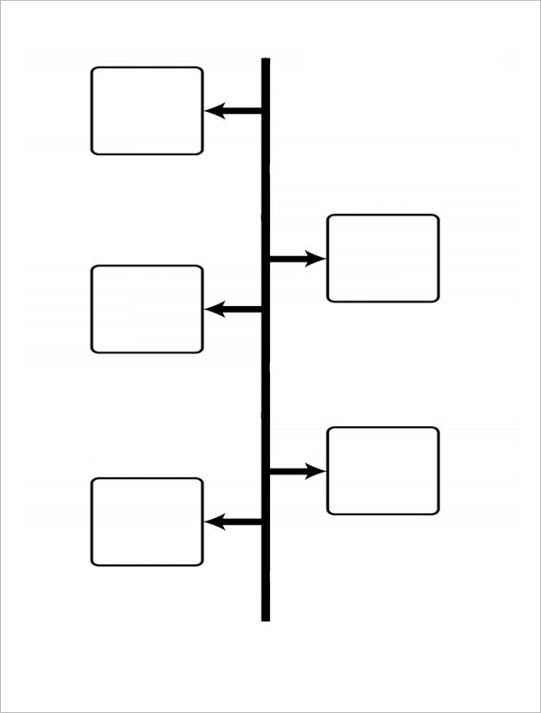
Project Timeline
Complete assigned
course on Coursera.
Search for a suitable
API to power the project.
Build the voice assistant
using Deep Learning.
Integrate the voice
assistant on a linux platform.
Use the voice assistant
to perform basic
system functions.

Slide 4
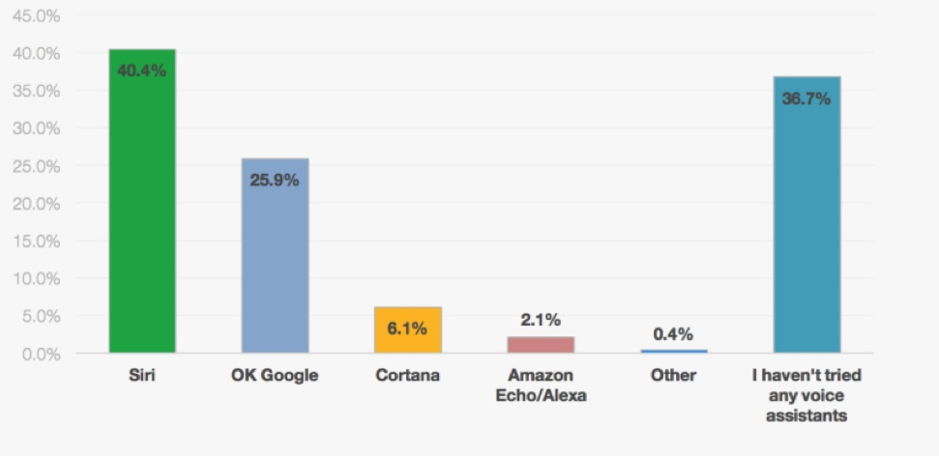
Why Choose Voice Assistant as a project?

Slide 5
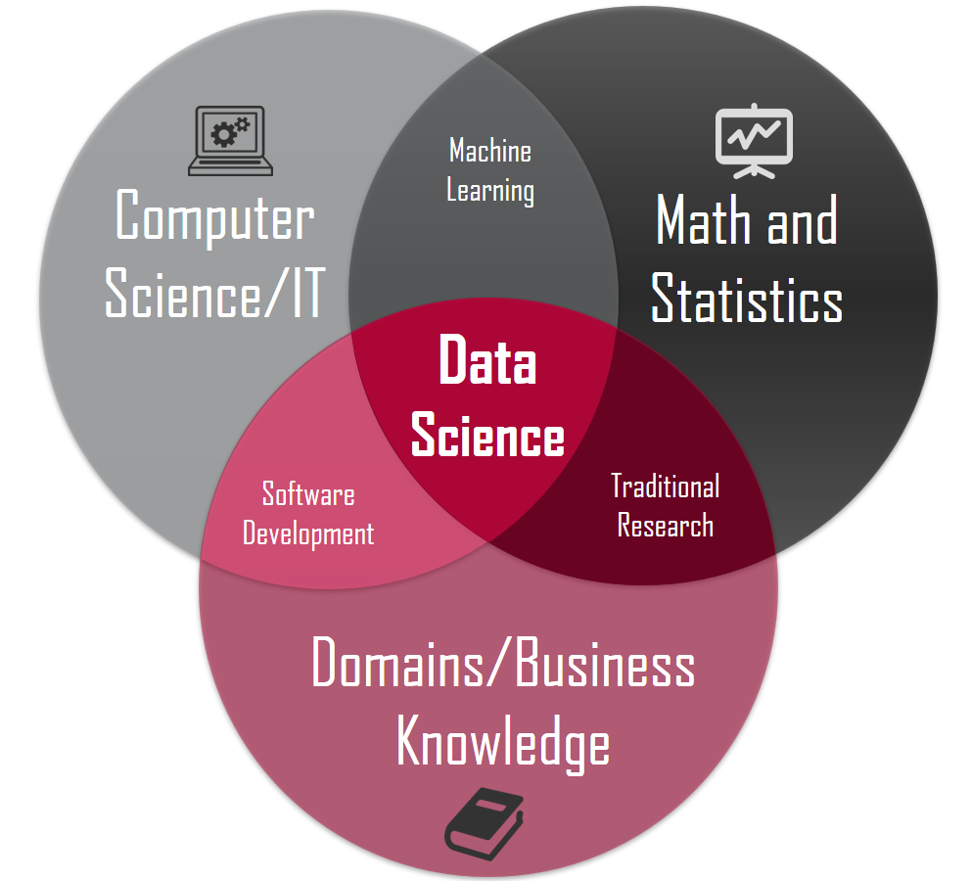

Slide 6
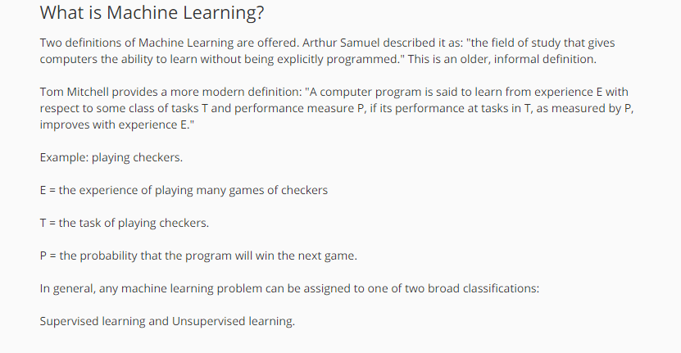

Slide 7
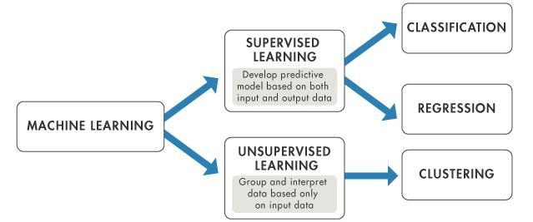

Slide 8
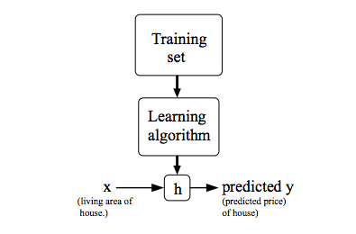

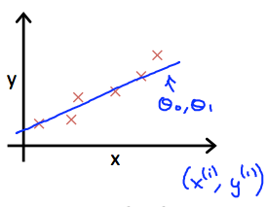

Cost Function

Slide 9
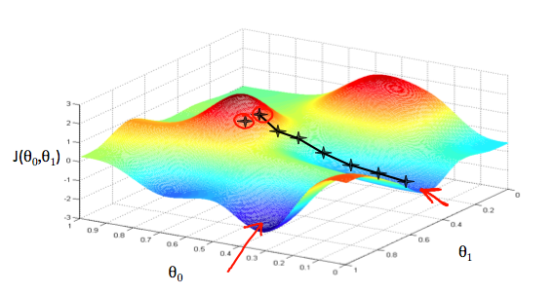
Gradient Descent

Slide 10

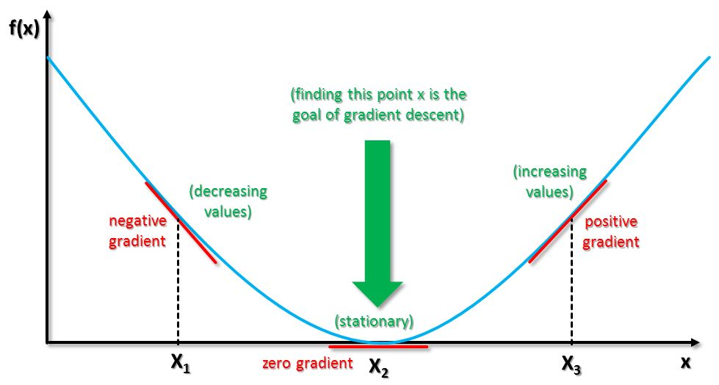
Gradient Descent

Slide 11
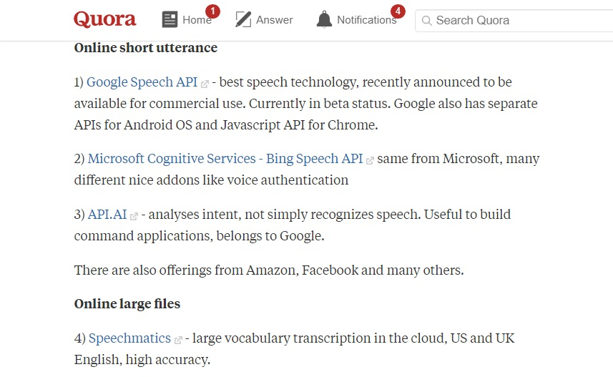

Slide 12
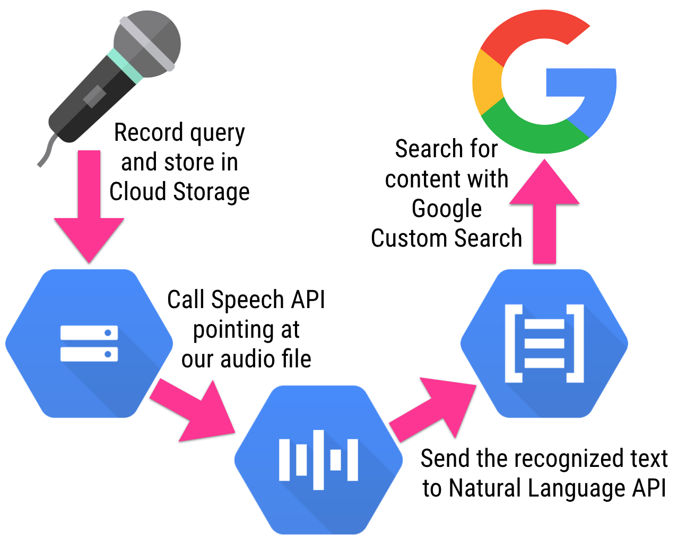

Slide 13
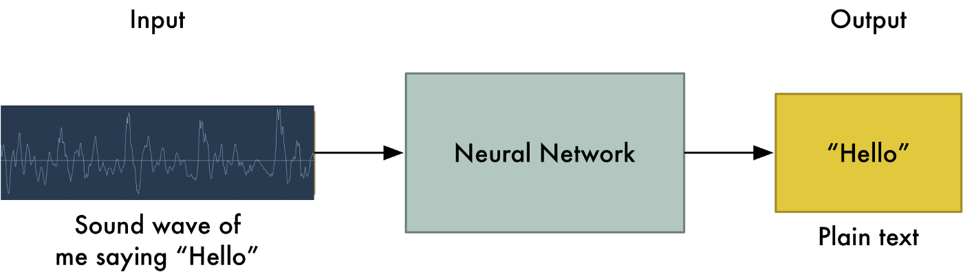
How to do Speech Recognition

Slide 14
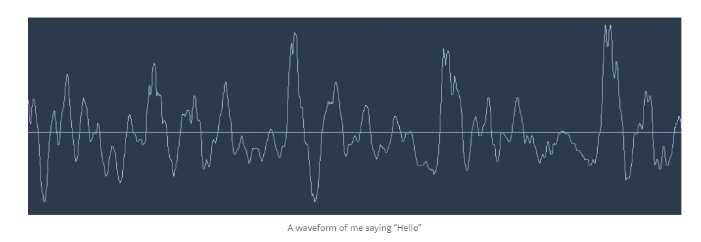

Slide 15
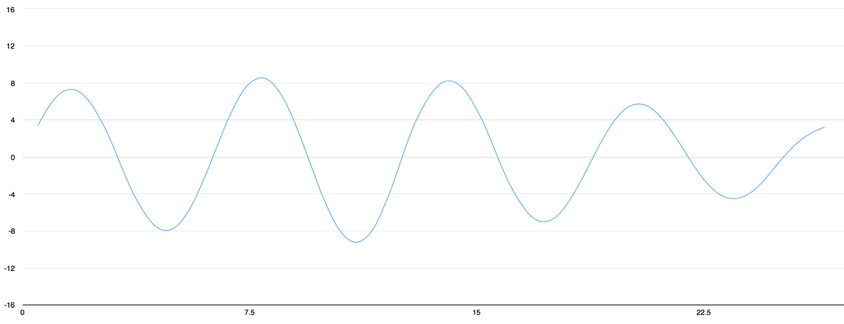
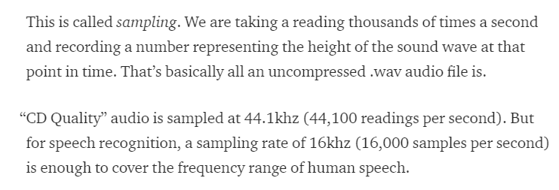

Slide 16
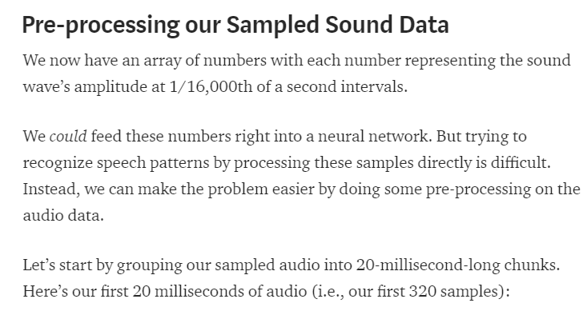

Slide 17
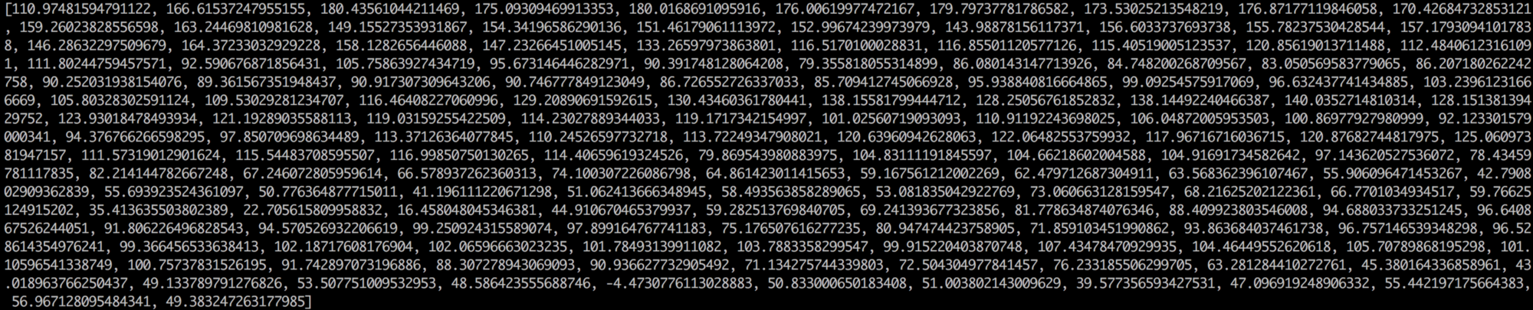
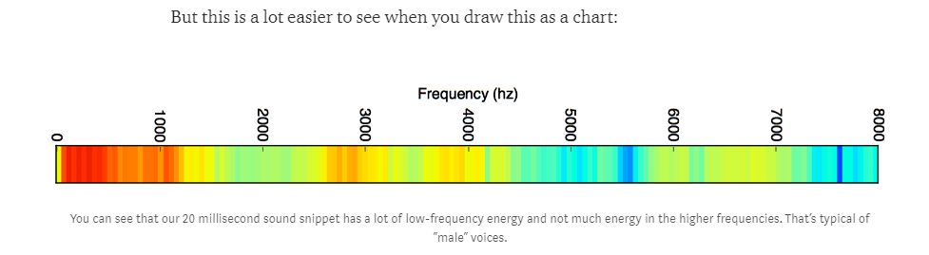
Each number in the list represents how much energy was in that 50hz frequency band

Slide 18
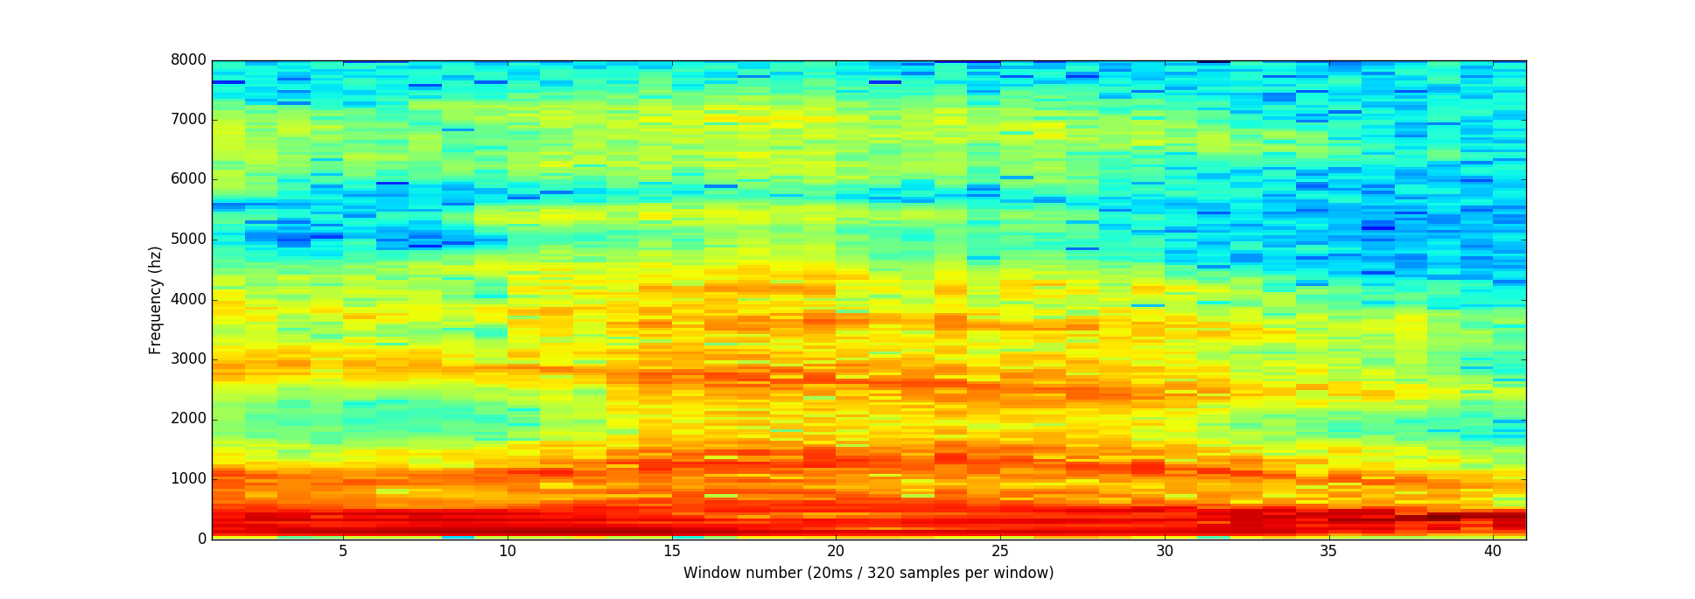
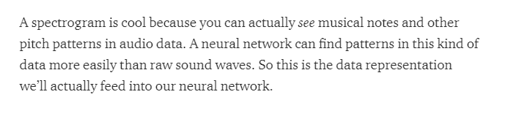
If we repeat this process on every 20 millisecond chunk of audio, we end up with a spectrogram (each column from left-to-right is one 20ms chunk):

Slide 19
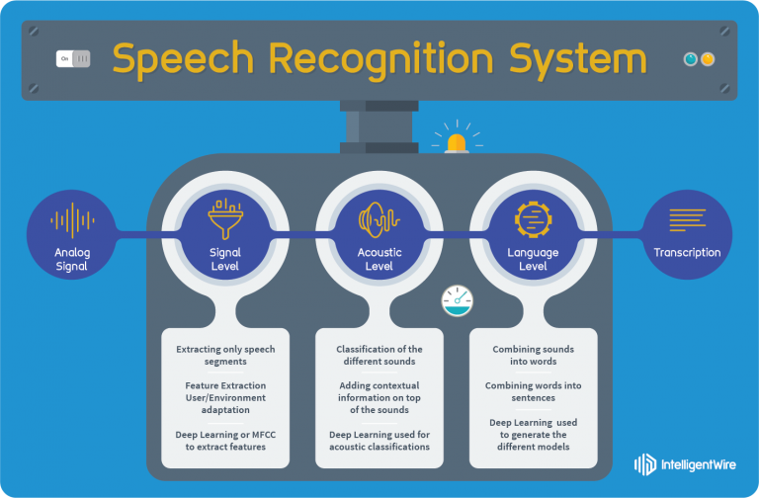

Slide 20
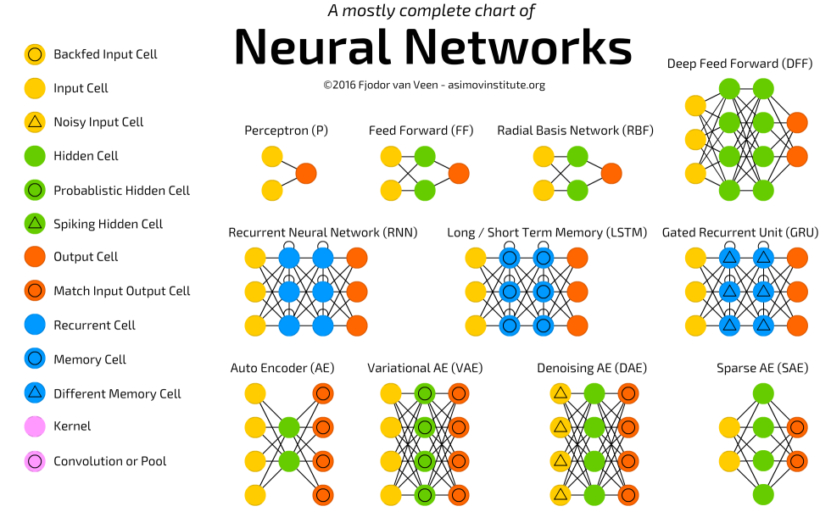

Slide 21


